Slide 1

Overview
Digital Assistant use-case
Demo
Notional Architecture
Blockchain use-case
Demo
Notional Architecture

Slide 2

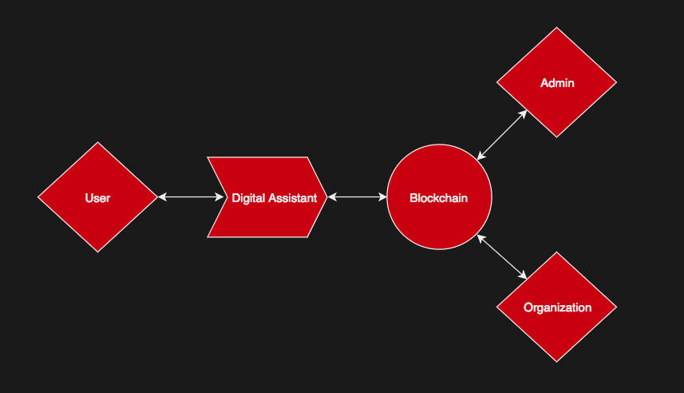
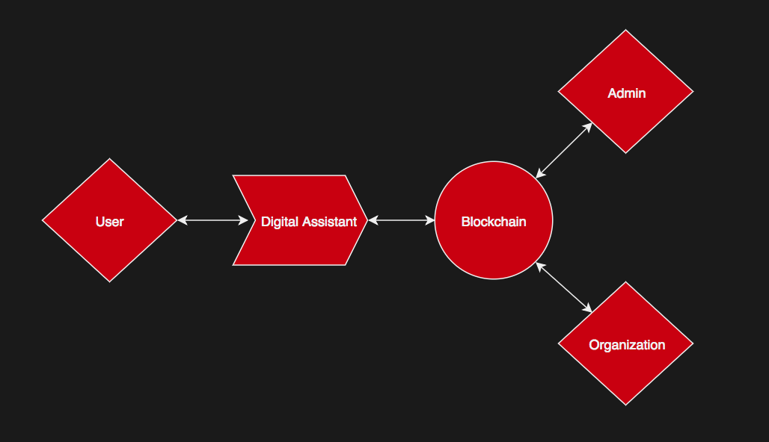
Over-arching design
Users have permanent and transparent record
User profile changes

Slide 3
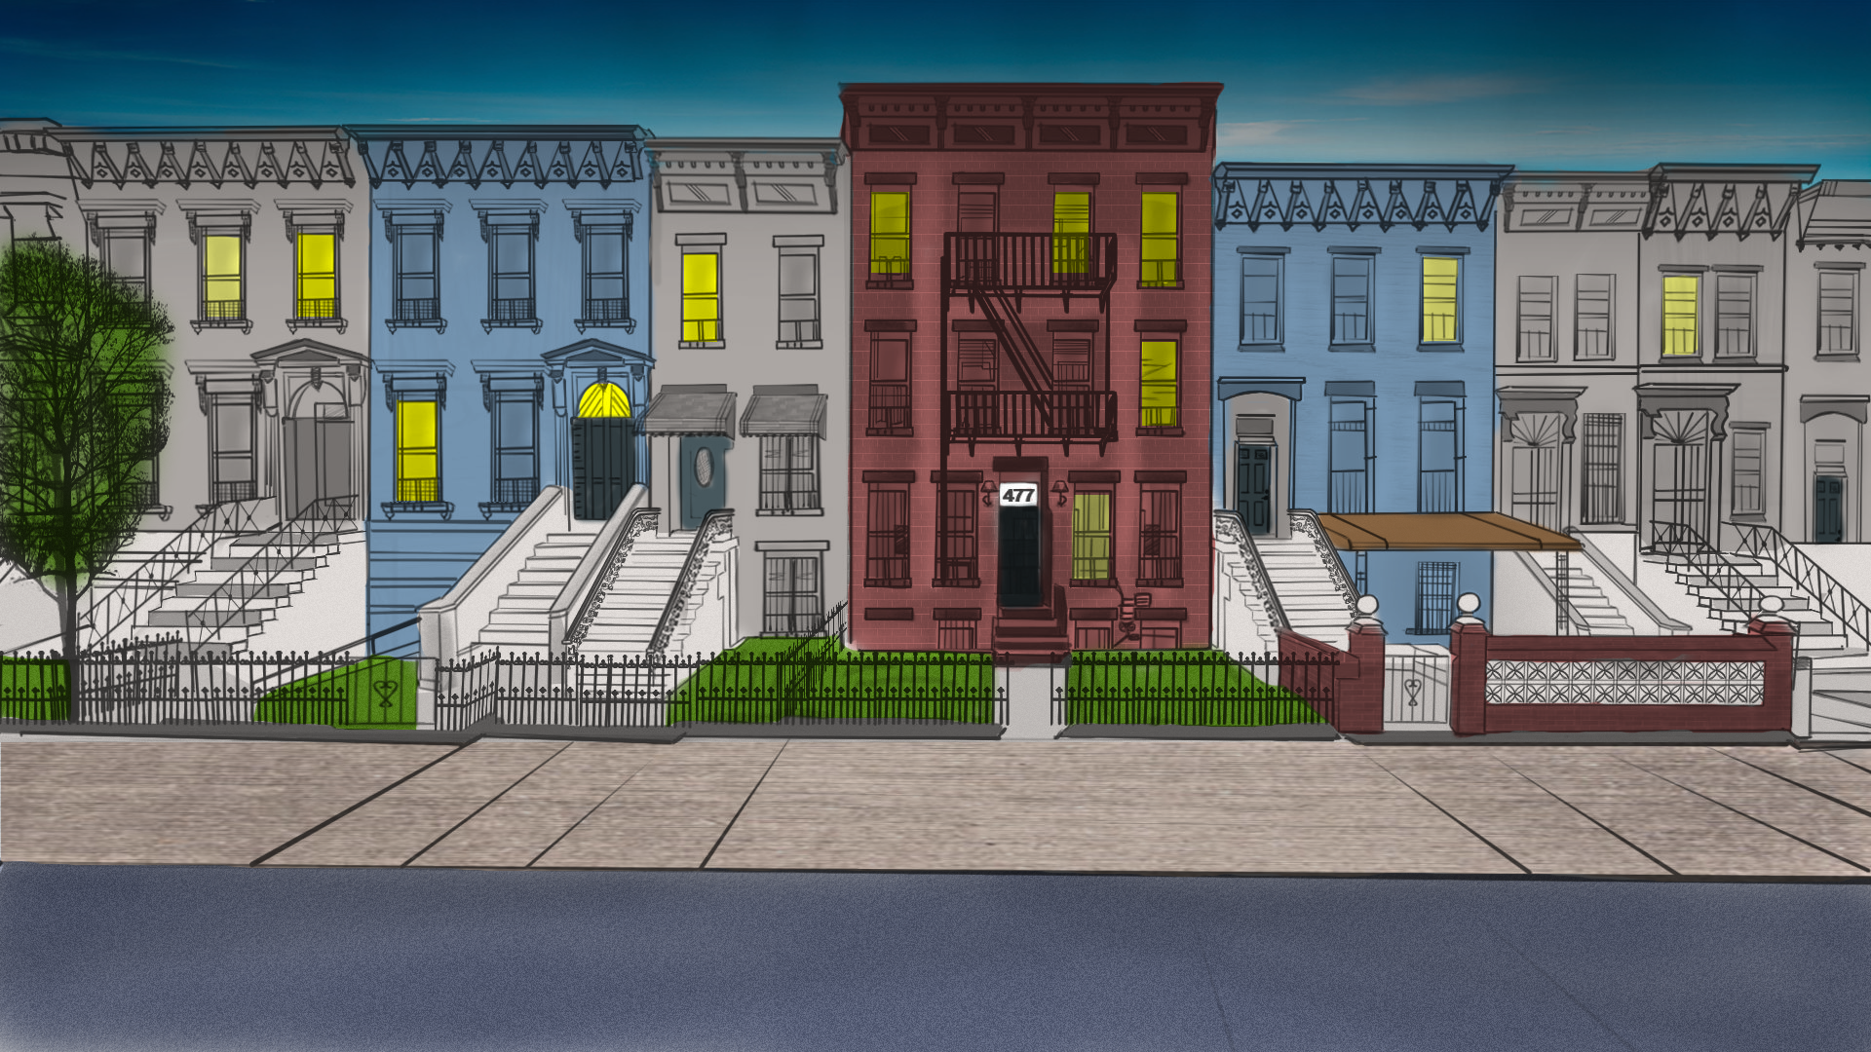
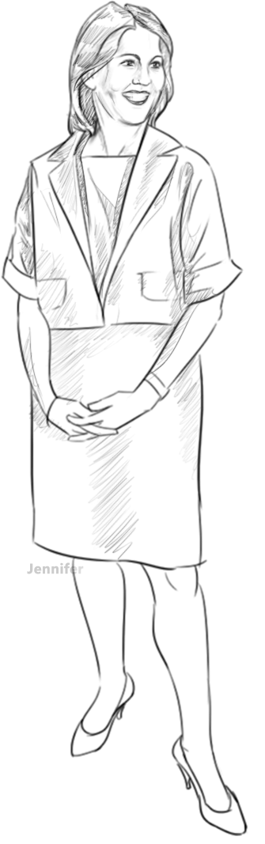
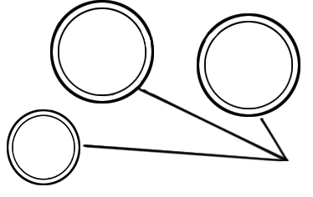
Onboarding Digital Assistant
Update HCM profile
Benefits and checklist
Notification System

Slide 4
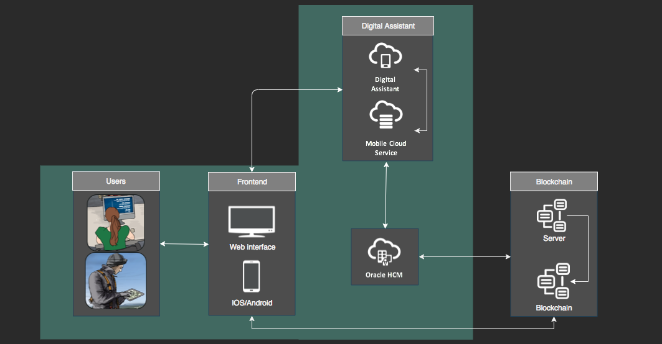
Notional Architecture

Slide 5

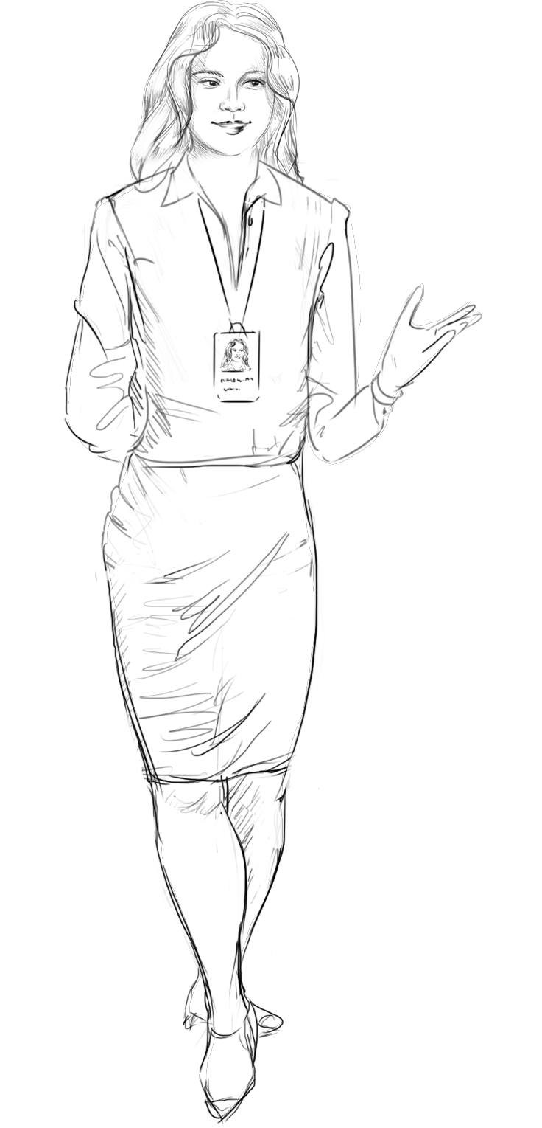

Blockchain
Change reflected into Blockchain
Users have permanent and transparent record
User profile changes
Permanent milestone history

Slide 6
Block Chain Values
Increase productivity and lower costs – Blockchain is decentralized
Streamlines the onboarding process - Users can privately access
Integrates with third-party systems - BC easily integrates using APIs
Supports growth with streamlined best-practice HR business processes - blockchain is great for scalability
Minimize your organization’s legal and financial risks - BC encrypted data disallows hacking and minimizes risk as compared to databases

Slide 7
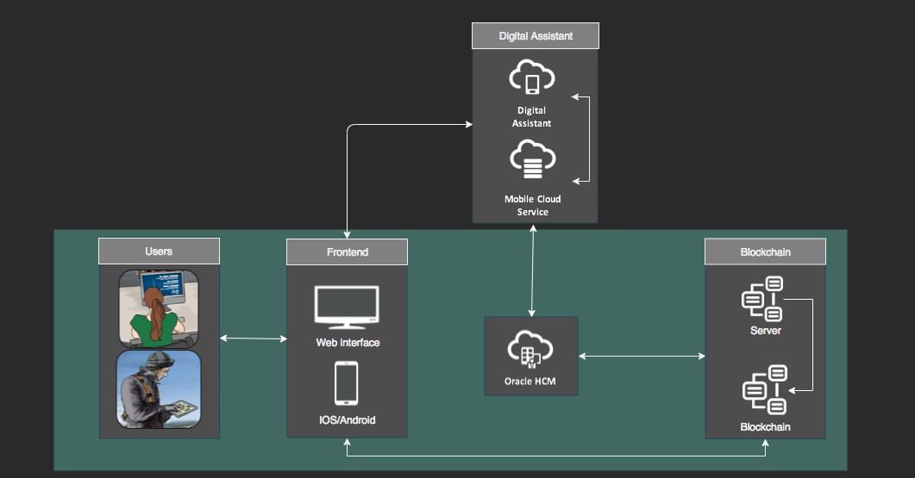
Notional Architecture

Slide 8
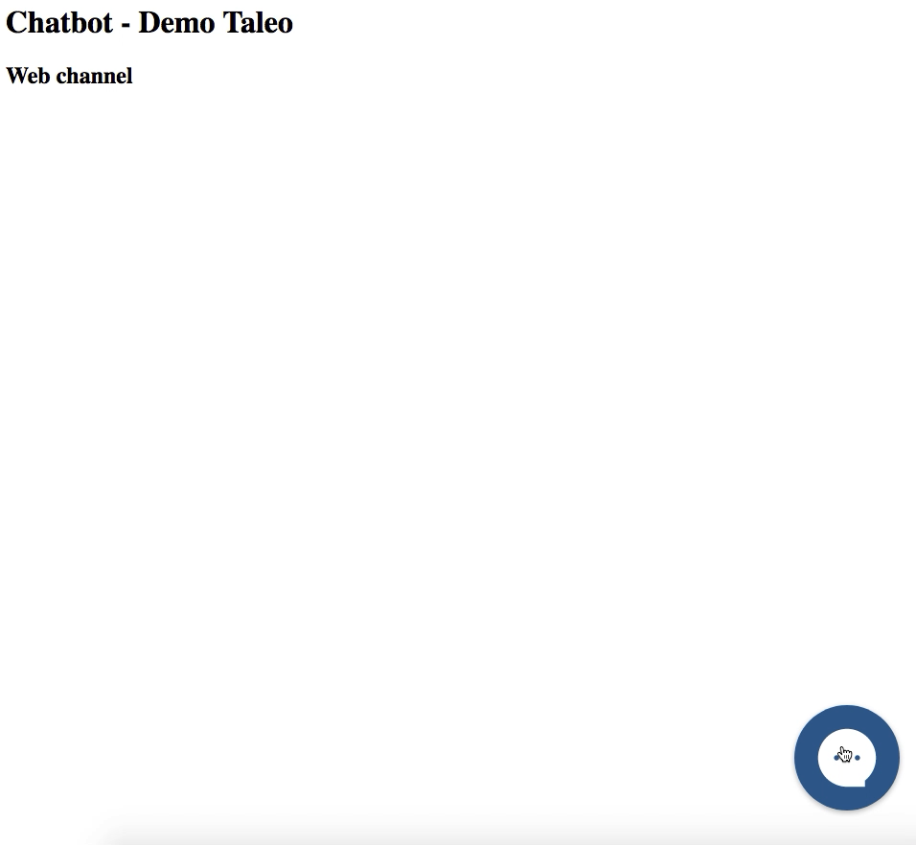
Notional Architecture

